Slide 1

COP 6731: Theory and Implementation of Database Systems
Relational Data Model

Slide 2
Outline of the Lecture
Goal:
Understand Relational Data Model
Introduction to Structured Query Language (SQL) Language
Relational Model
Conceptual Model
Logical Model
Model Constraints (e.g., Primary Key, Foreign Key, NULL, UNIQUE, etc.)
Operations (e.g., selection, projection, cross product join, etc.)
Oracle SQL Tutorial
DDL/DML
Data Type

Slide 3
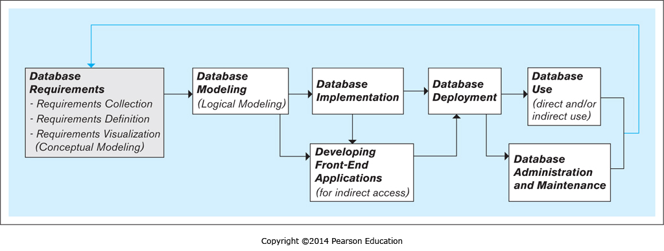
Database Development
Requirement analysis is the process of determining the needs and expectations for a new or modified product.

Slide 4
Relational Model
Edgar F. Codd proposed the relational model in 1970 (IBM Research)
Relational model represents the database as a collection of relations.
Relation represents entity or relationship.
Relation is defined as a set of rows (or tuples).
All rows in a relation must be distinct.

Slide 5
Conceptual Data model
Entity
Real-world object (e.g., employee)
Attribute
Property of entity (e.g., id, name, age, etc.)
Relationship
Association among two or more entities

Slide 6
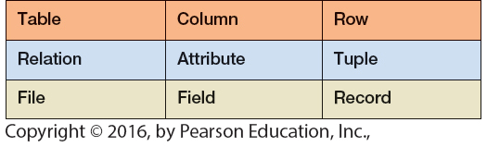
Relational Data model
The relational model is a record-based model.
The relational model uses a collection of tables to represent both data and the relationships among those data.
Relational Model | Database Term
relation | table
tuple | row

Slide 7
Cardinality and Degree
Given relation R, Cardinality (|R|) is the total number of rows (or tuples). Degree refers to the number of columns (or attributes) in a table (or relation).
Every value in a row (or tuple) is an atomic value.
NULL can be used in special cases (e.g., unknown, not available).
No two rows (or tuples) in a relational table are identical.

Slide 8
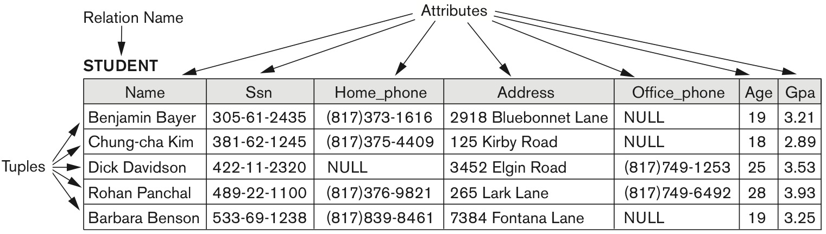
Relation
Relational Schema
STUDENT(Name, Ssn, Home_phone, Address, Office_phone, Age, Gpa)
What is the cardinality of the STUDENT table?
What is the degree of the STUDEN table?

Slide 9
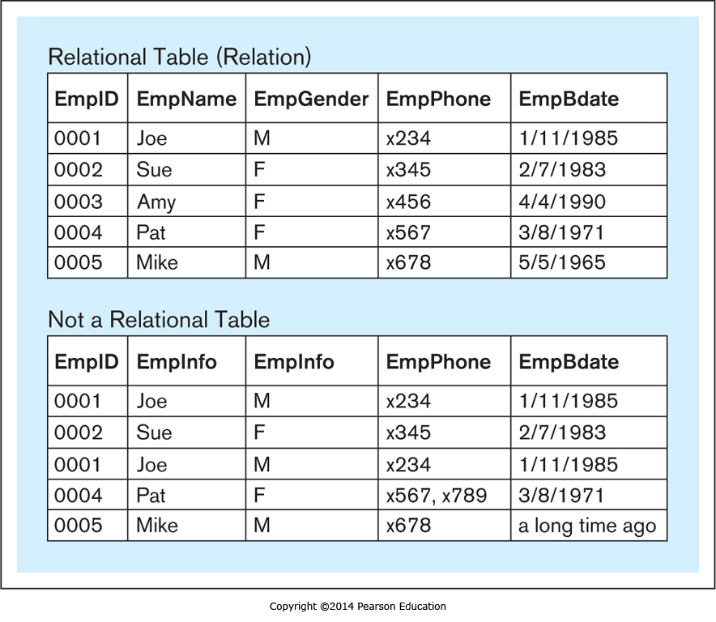
Example

Slide 10
Example
Every value in a row (or tuple) is an atomic value.
No two rows in a relational table are identical.

Slide 11
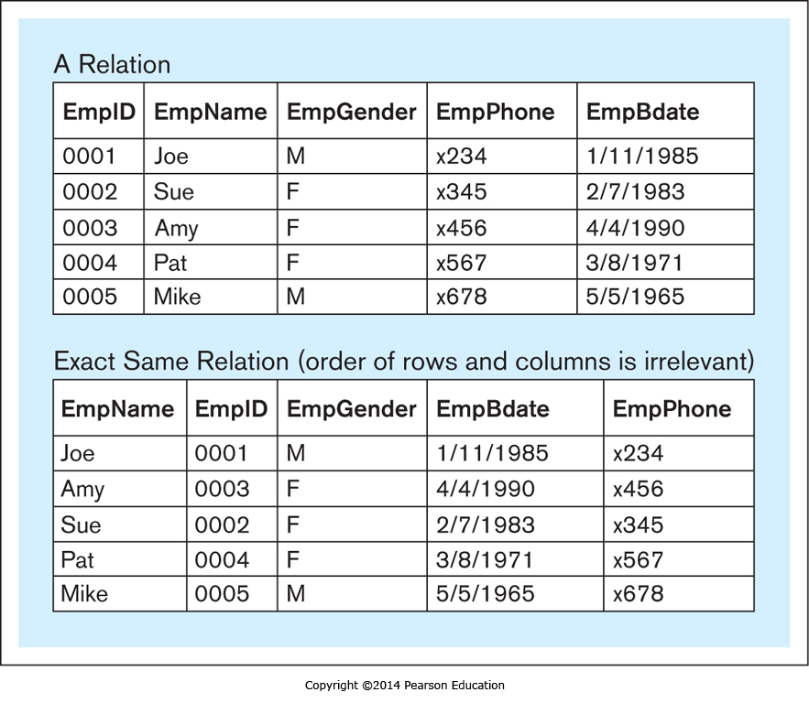
Example

Slide 12
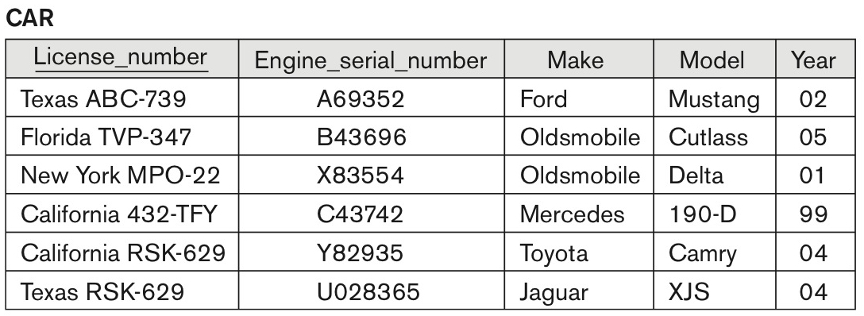
Relation Model Constraints
All rows in a relation must be distinct.
A superkey is a set of attributes that must be distinct in a relation.
A minimal superkey is a minimum set of attributes necessary to be distinct in a relation.
The CAR relation, with two candidate keys: License_number and Engine_serial_number.

Slide 13
Relation Model Constraints (Primary Key)
A minimum superkey (or candidate key) can be used to identify uniquely each row (or tuple) in the relation.
A relation may have more than one minimum superkey (i.e., candidate key).
We can choose one of the candidate keys as the primary key (PK).
No primary key value can be NULL.

Slide 14
Domain
A domain is a set of values that can be assigned to an attribute.
A simple definition of a database domain is the data type used by a column in a database.
Oracle examples
CHAR
VARCHAR2
NUMBER
INT
DATE
TIMESTAMP

Slide 15
Relation Model Constraints (Foreign Key)
Foreign Key (FK)
The attributes in Foreign Key (FK) of R1 have the same domain(s) as the attributes in Primary Key (PK) of R2.
Foreign Key (FK) of R1 refers to Primary Key (PK) of R2.
The value of Foreign Key(FK) can be NULL.
Foreign Key can refer to its own relation.
Student
University
SID | SSN | NAME | UID
Z01 | 12344555 | James | 1
Z02 | 32322322 | Mike | 2
Z03 | 21323111 | Paul | NULL
Z04 | 31224321 | Sam | 1
UID | NAME
1 | A University
2 | B University
3 | C College
4 | D University

Slide 16
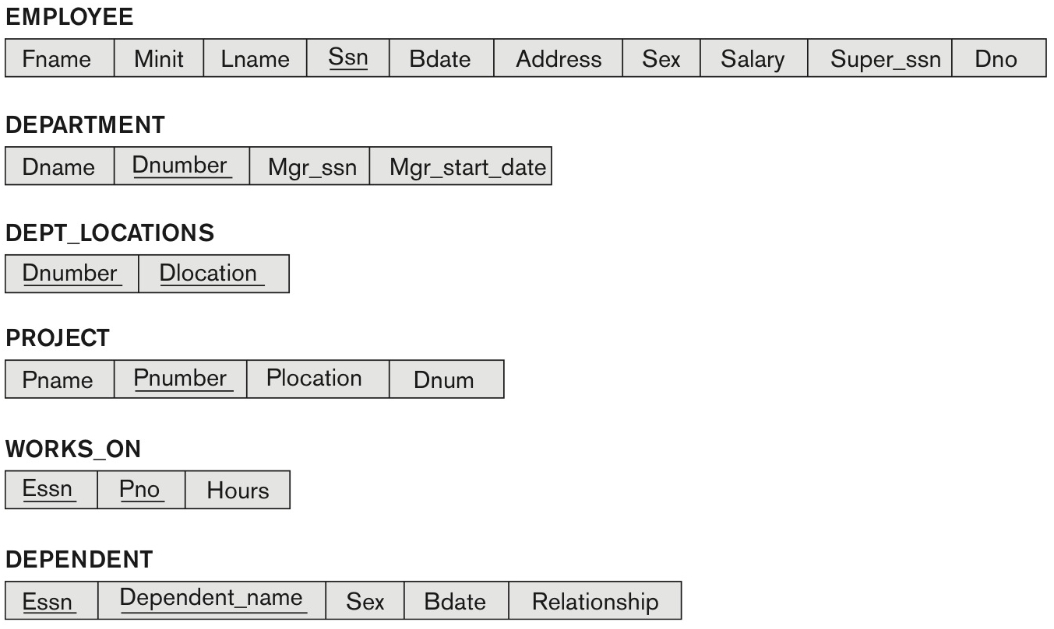
Relation Model Constraints (Primary Key)
(Ssn)
(Dnumber)
(Dnumber, Dlocation)
(Pnumber)
(Essn, Pno)
(Essn, Dependent_name)

Slide 17
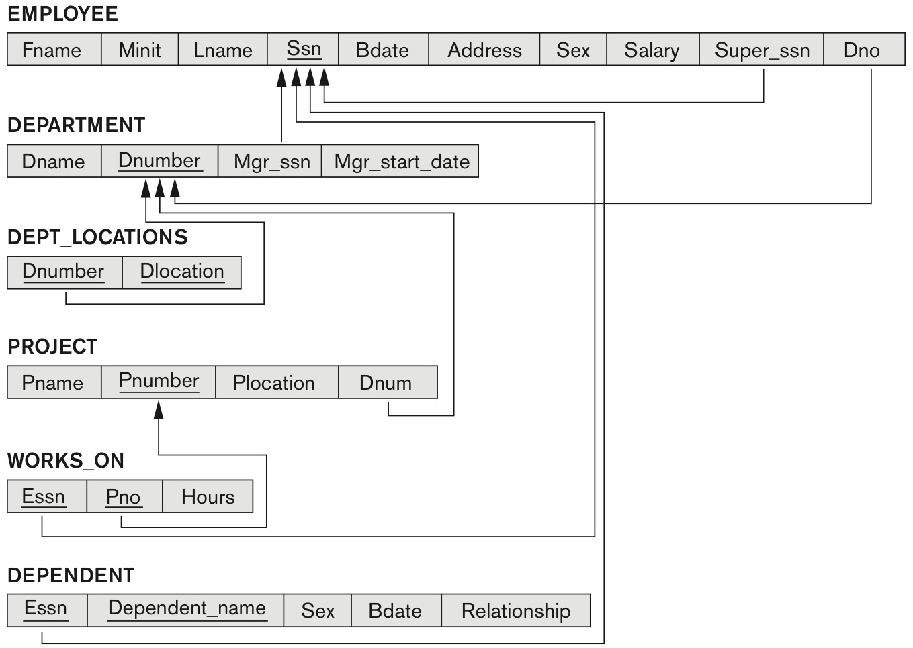
Relation Model Constraints (Foreign Key)
A foreign key refers to a candidate key
( Dno → Dnumber )
( Super_ssn → Ssn)
( Mgr_ssn → Ssn )
( Dnumber → Dnumber )
( Dnum → Dnumber )
(Pno → Pnumber )
( Essn → Ssn)
( Essn → Ssn )

Slide 18
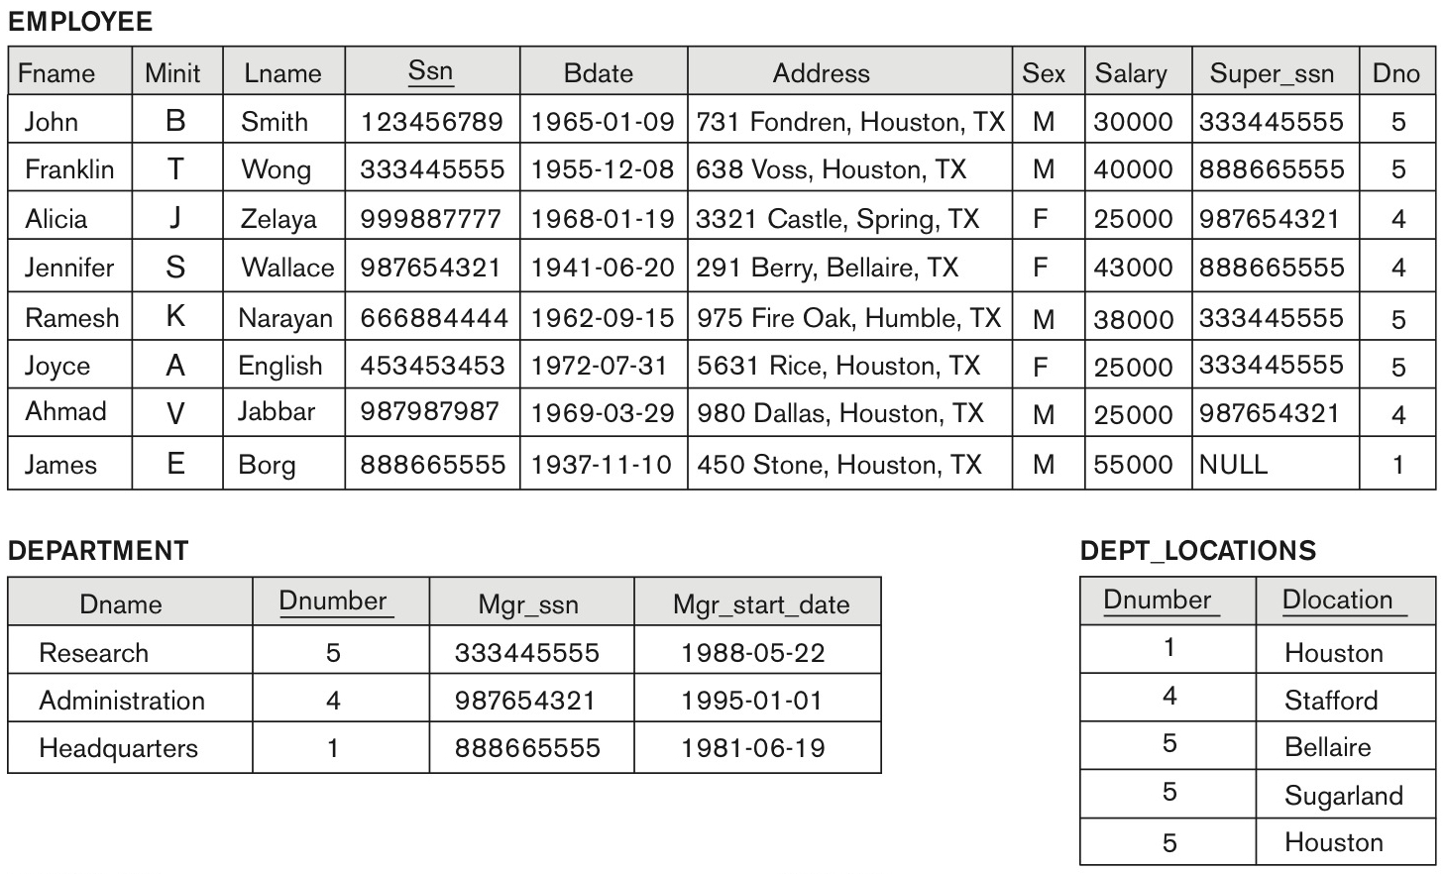
How many FKs can we find here?

Slide 19
How many FKs can we find here?

Slide 20
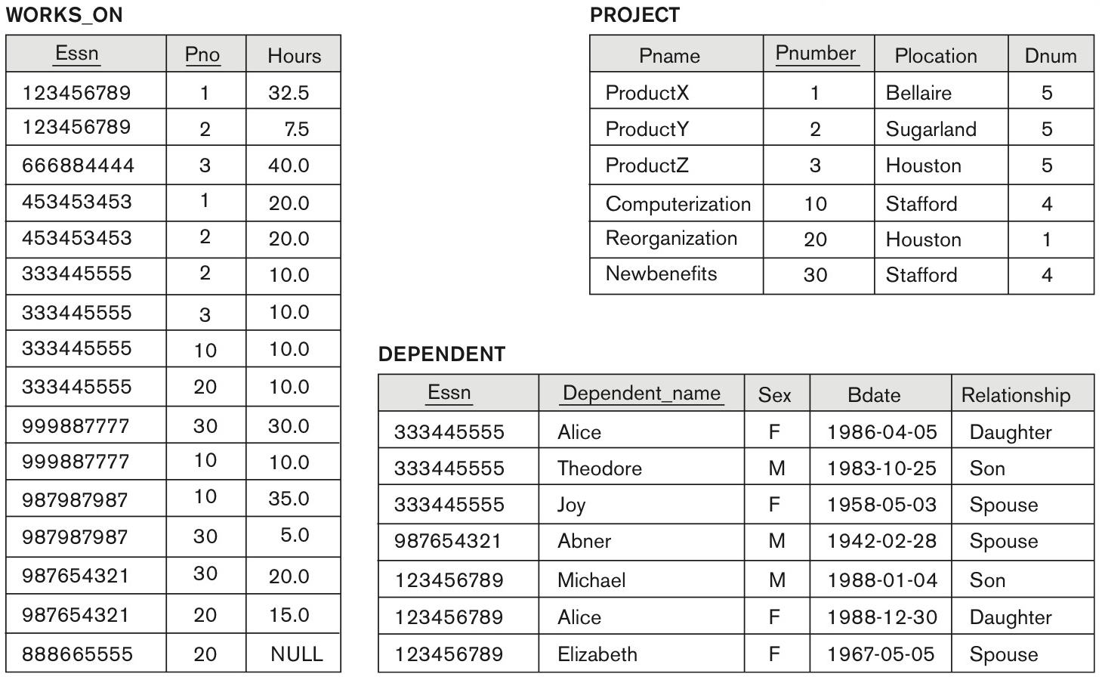
How many FKs can we find here?

Slide 21
Constraint Violations
Student
University
PK
FK
PK
SID | SSN | NAME | UID
Z01 | 111-11-1111 | James | 1
Z02 | 22-22-2222 | Mike | 2
Z03 | 33-33-3333 | Paul | NULL
Z04 | 44-44-4444 | Sam | 1
UID | NAME
1 | A University
2 | B University
3 | C College
4 | D University
Which one violates constraints ?
Insert <Z03, 555-55-555, Robert, 2> into the Student table.
Insert <NULL, 777-77-777, Elizabeth, 3> into the Student table.
Insert <Z05, 888-88-888, Sam, 5> into the Student table.
Insert <Z07, 999-99-999, Paul, 4> into the Student table.
Insert <Z09, 555-55-555, Paul, NULL> into the Student table.

Slide 22
Constraint Violations
Student
University
PK
FK
PK
SID | SSN | NAME | UID
Z01 | 111-11-1111 | James | 1
Z02 | 22222222 | Mike | 2
Z03 | 33333333 | Paul | NULL
Z04 | 44444444 | Sam | 1
UID | NAME
1 | A University
2 | B University
3 | C College
4 | D University
Which one violates constraints ?
Delete from the University table where UID = 1
Delete from the University table where UID = 2
Delete from the University table where UID = 3

Slide 23
Constraint Violations
Student
University
PK
FK
PK
SID | SSN | NAME | UID
Z01 | 111-11-1111 | James | 1
Z02 | 222-22-222 | Mike | 2
Z03 | 333-33-333 | Paul | NULL
Z04 | 444-44-444 | Sam | 1
UID | NAME
1 | A University
2 | B University
3 | C College
4 | D University
Which one violates constraints ?
Update the University table set UID=2 where UID = 1
Update the University table set UID=2 where UID = 5
Update the Student table set UID=5 where SID = ‘Z04’
Update the Student table set UID=2 where SID = ‘Z04’

Slide 24
Basic SQL Syntax
Operations | SQL
Insert | INSERT INTO table_name (column1, column2, column3,...) VALUES (value1, value2, value3, ...);
Retrieve | SELECT column1, column2, column3,... FROM table_name;
Update | UPDATE table_name SET column1=value1, column2=value2,... WHERE some_column=some_value;
Delete | DELETE FROM table_name WHERE some_column=some_value;

Slide 25
Oracle Database Tutorial

Slide 26
SQL
Data Definition Language (DDL) - A language that allows the DBA or user to describe and name the entities, attributes, and relationships required for the application, together with any associated integrity and security constraints.
Data Manipulation Language (DML) - A language that provides a set of operations to support the basic data manipulation operations on the data held in the database.

Slide 27
SQL
Data Definition Language (DDL)
Create Table
Drop Table
Data Manipulation Language (DML)
Insert row(s) (or tuple(s))
Retrieve row(s) (or tuple(s))
Update row(s) (or tuple(s))
Delete row(s) (or tuple(s))

Slide 28
Create Table Statement
CREATE TABLE table_name (
column_name datatype,
column_name datatype,
...
column_name datatype,
Entity Integrity Constraints, Referential Integrity Constraints );
Constraints
Domain Constraints can be defined as the definition of a valid set of values for an attribute.
Entity Integrity Constraints: each table in the database can have at most one PRIMARY KEY constraint
Referential Integrity Constraints: if a foreign key in Table B refers to the Primary Key of Table A, then every value of the Foreign Key in Table B must be null or be available in Table A.
Key Constraints: Keys can be used to uniquely identify a row. A table can have multiple keys, but out of which, one key will be the primary key.

Slide 29
Oracle DB Data Type (Domain Constraints)
Data Type | Description
VARCHAR2(size) | Variable-length character string having maximum length size bytes (or characters). The maximum size is 4000 bytes.
CHAR(size) | The CHAR datatype specifies a fixed-length character string.
NUMBER[(precision [, scale]]) | Number having precision p and scale s. If a value exceeds the precision, then Oracle returns an error. If a value exceeds the scale, then Oracle rounds it.
DATE | Valid date range from January 1, 4712 BC to December 31, 9999 AD.
TIMESTAMP | Year, month, and day values of date, as well as hour, minute, and second values of time.
BLOB | A binary large object.

Slide 30

Create Table with Entity Integrity Constraints
CREATE TABLE Employee (
Ssn CHAR (9),
Fname VARCHAR2 (15),
Minit VARCHAR2 (15),
Lname VARCHAR2 (15),
Bdate DATE,
Address VARCHAR2 (30),
Sex CHAR (1),
Salary NUMBER (10,2),
Super_ssn CHAR (9),
Dno NUMBER,
PRIMARY KEY (Ssn) );
CREATE TABLE Department(
Dnumber NUMBER,
Dname VARCHAR2 (15),
Mgr_ssn CHAR (9),
Mgr_start_date DATE,
PRIMARY KEY (Dnumber) );

Slide 31
Entity Integrity Constraints (Primary Key)
CREATE TABLE table_name (
column_name data_type PRIMARY KEY,
column_name data_type,
column_name data_type,
… );
CREATE TABLE table_name (
column_name data_type,
column_name data_type,
column_name data_type,
…
CONSTRAINT key_name PRIMARY KEY (list of column_names) );

Slide 32
Constraints (NOT NULL, UNIQUE, FOREIGN KEY)
CREATE TABLE table_name (
column_name data_type PRIMARY KEY,
column_name data_type NOT NULL,
column_name data_type UNIQUE,
… );
CREATE TABLE table_name_B (
column_name data_type PRIMARY KEY,
column_name data_type,
column_name data_type,
…
CONSTRAINT fk_name FOREIGN KEY (column_name_B) REFERENCES table_name_A (column_name_A)
);

Slide 33
Examples (Primary Key)
CREATE TABLE customers (
id NUMBER(10) NOT NULL,
name VARCHAR2 (50) NOT NULL,
city VARCHAR2 (50) );
CREATE TABLE customers (
id NUMBER(10) NOT NULL,
name VARCHAR2(50) NOT NULL,
city VARCHAR2(50),
CONSTRAINT cust_pk PRIMARY KEY ( id ) );

Slide 34
Examples (NOT NULL, FOREIGN KEY)
CREATE TABLE departments (
id NUMBER(10) NOT NULL,
name VARCHAR2(50) NOT NULL DEFAULT ‘FAU’,
CONSTRAINT dept_pk PRIMARY KEY ( id ) );
CREATE TABLE employees (
id NUMBER(10) NOT NULL,
name VARCHAR2(50) NOT NULL,
dept_id NUMBER(10),
salary NUMBER(6),
CONSTRAINT emp_pk PRIMARY KEY ( id ),
CONSTRAINT emp_fk_dept FOREIGN KEY ( dept_id )
REFERENCES departments ( id ) );

Slide 35
Create table from another table
CREATE TABLE new_table AS (
SELECT * FROM old_table );
CREATE TABLE suppliers AS (
SELECT *
FROM companies
WHERE id < 5000 );
The asterisk ‘*’ is used in conjunction with the SELECT keyword to select all columns (or fields) from a table or a query.

Slide 36
Drop Table
DROP TABLE table_name;
Examples)
DROP TABLE departments;
DROP TABLE employees;

Slide 37
Insert Row
INSERT INTO table_name ( column1, column2, ... column_n )
VALUES ( value1, value2, ... value_n );
Example)
INSERT INTO suppliers (id, name) VALUES (5000, 'Apple');
INSERT INTO suppliers (id, name, age) VALUES (5000, 'Apple', NULL);

Slide 38
Update Row(s)
The UPDATE command is used to change or modify data values in a table.
UPDATE table_name
SET column1 = value1, column2 = value2, ... , column_n = value_n
WHERE conditions;
Example)
UPDATE customers
SET name = 'James'
WHERE id = 3000;
UPDATE customers
SET id =5000, home='Boca Raton'
WHERE id > 100;

Slide 39
Delete Row(s)
The DELECT command deletes rows (or tuples) from the tables that satisfies the condition provided by the WHERE clause.
DELETE FROM table_name
WHERE conditions;
Example)
DELETE FROM customers
WHERE id = 3000;
DELETE FROM customers
WHERE id > 100;

Slide 40
Retrieve Row(s)
SELECT list of column names
FROM list of table names
WHERE conditions;
Example)
SELECT *
FROM student
WHERE age >= 18
SELECT name, id
FROM student
WHERE age >= 18
The asterisk ‘*’ is used in conjunction with the SELECT keyword to select all columns (or fields) from a table or a query.

Slide 41
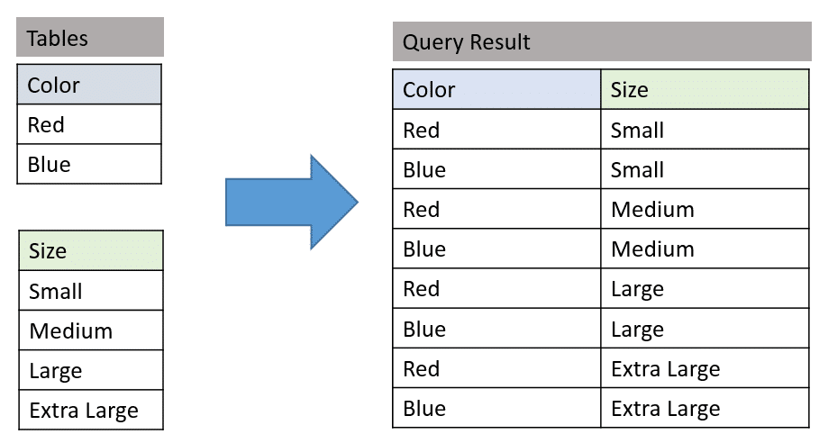
Cartesian product (or Cross product)
Given two relations (or tables) R and S, Cartesian product of R and S (i.e., R ✕ S) returns all possible combinations of R and S.

Slide 42
Quiz
Given two relations (e.g., R and S), where |R| = n and |S| = m, the cardinality of R ✕ S (i.e., |R ✕ S|) is ______.
What is the difference between relation and database table?

Slide 43
Demo
How to access Oracle database
Access VMware through https://portal.eng.fau.edu
Install a terminal emulator (e.g., ssh or Putty).
Connect to 'oraclelinux.eng.fau.edu' using id and password.
Enter the SQL*Plus command: sqlplus.
When prompted, enter your Oracle Database username and password.

Slide 44
Take home message
Relational Data Model
Constraints and Violations
Oracle SQL syntax
Create Table
Drop Table
Create Row
Retrieve Row(s)
Update Row(s)
Delete Row(s)

